Slide 1

JAVA
Exception Handling

Slide 2
What is Exception
An Exception is an unwanted event that interrupts the normal flow of the program. When an exception occurs program execution gets terminated.
In such cases we get a system generated error message.
The good thing about exceptions is that they can be handled in Java.
By handling the exceptions we can provide a meaningful message to the user about the issue rather than a system generated message, which may not be understandable to a user.
Why an exception occurs?
There can be several reasons that can cause a program to throw exception. For example: Opening a non-existing file in your program, Network connection problem, bad input data provided by user etc.

Slide 3
Exception in thread "main" java.lang.ArithmeticException: / by zero at ExceptionDemo.main(ExceptionDemo.java:5)
Exception Demo : The class name
main : The method name
ExceptionDemo.java : The filename
java:5 : Line number
This message is not user friendly so a user will not be able to understand what went wrong. In order to let them know the reason in simple language, we handle exceptions.
Advantage of Exception handling ensures that the flow of the program doesn’t break when an exception occurs Types of Exception example given below.
NullPointerException – When you try to use a reference that points to null.
ArithmeticException – When bad data is provided by user, for example, when you try to divide a number by zero this exception occurs because dividing a number by zero is undefined.
ArrayIndexOutOfBoundsException – When you try to access the elements of an array out of its bounds, for example array size is 5 (which means it has five elements) and you are trying to access the 10th element.

Slide 4
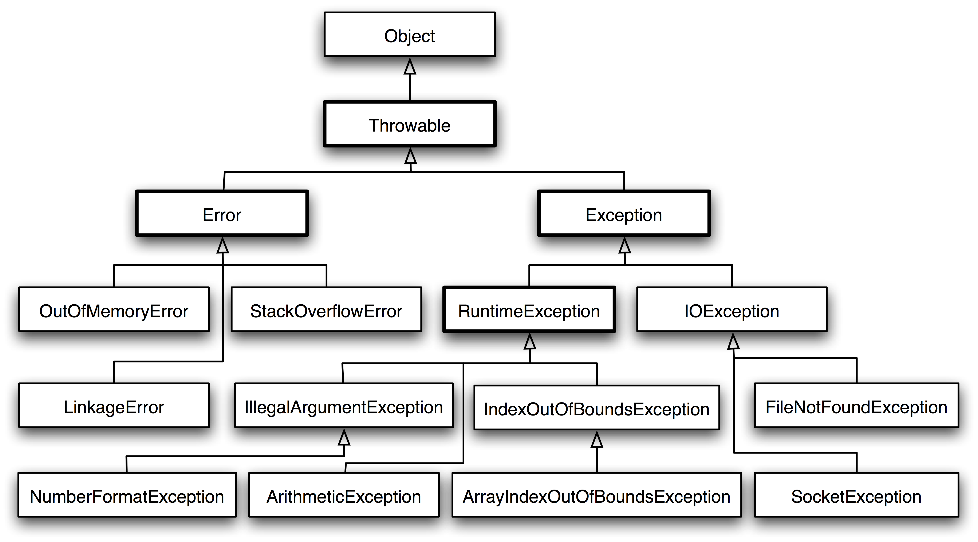

Slide 5
Type of Exception
Checked Exception
All exceptions other than Runtime Exceptions are known as Checked exceptions as the compiler checks them during compilation to see whether the programmer has handled them or not. If these exceptions are not handled/declared in the program, you will get compilation error.
For example : SQLException, IOException, ClassNotFoundException etc.
Unchecked Exception
Runtime Exceptions are also known as Unchecked Exceptions. These exceptions are not checked at compile-time so compiler does not check whether the programmer has handled them or not but it’s the responsibility of the programmer to handle these exceptions and provide a safe exit.
For example :ArithmeticException, NullPointerException, ArrayIndexOutOfBoundsException etc.

Slide 6
Try Catch For Exception Handling
Try block
Catch block
Multiple catch blocks
Finally block

